Slide 1
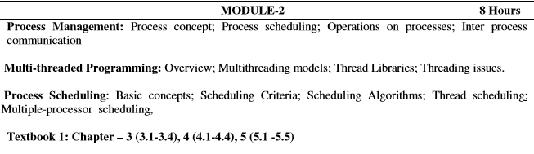
MODULE 2

Slide 2
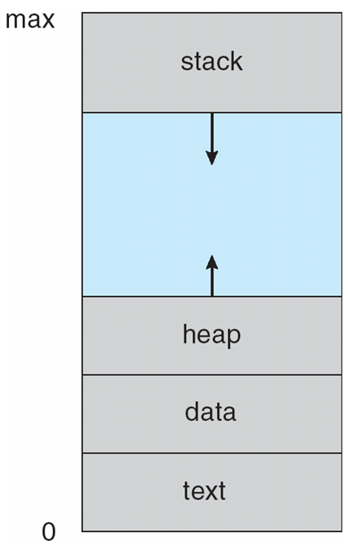
Process Concept
An operating system executes a variety of programs:
  Batch system – jobs
  Time-shared systems – user programs or tasks
Textbook uses the terms job and process almost
interchangeably
Process – a program in execution; process execution
must progress in sequential fashion
A process includes:
  program counter
  stack
  data section
  Process in Memory

Slide 3
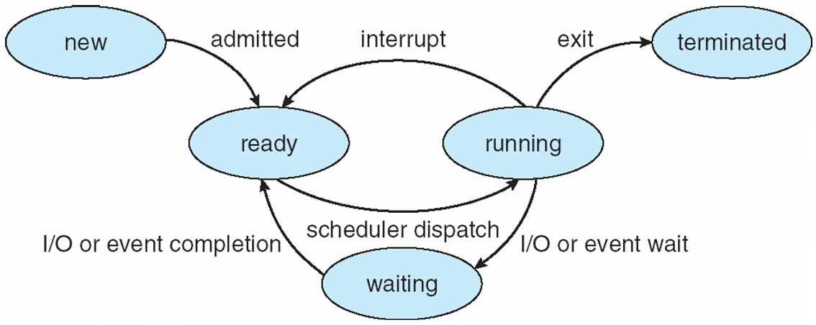
Process State
As a process executes, it changes state
  new: The process is being created
  running: Instructions are being executed
  waiting: The process is waiting for some event to occur
  ready: The process is waiting to be assigned to a processor
  terminated: The process has finished execution
  Diagram of Process State

Slide 4
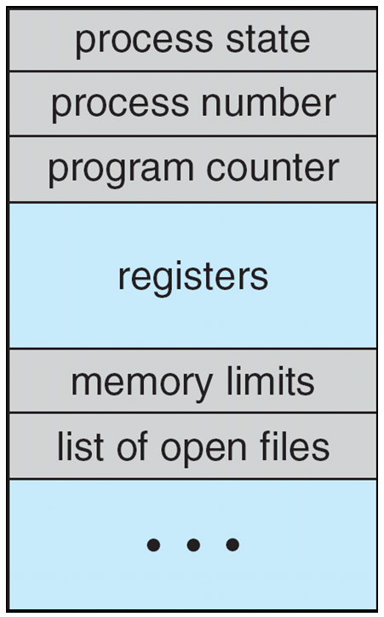
Process Control Block (PCB)
Information associated with each process
Process state
Program counter
CPU registers
CPU scheduling information
Memory-management information
Accounting information
I/O status information
Process Control Block (PCB)

Slide 5
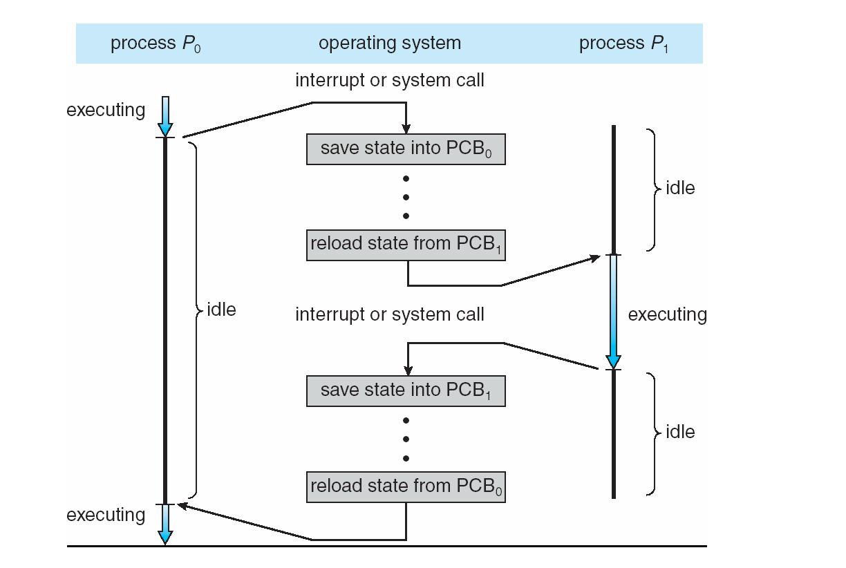
CPU Switch From Process to Process

Slide 6
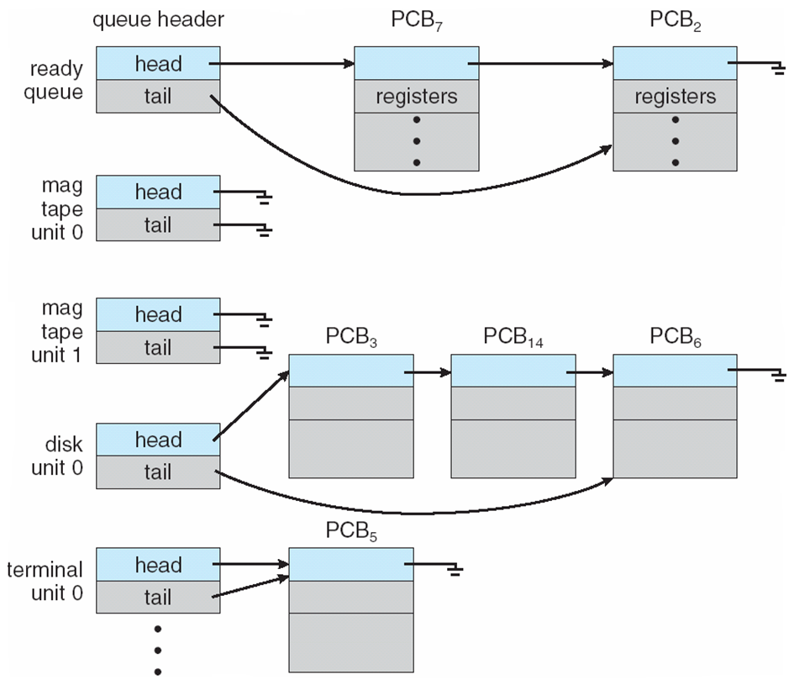
Process Scheduling Queues
Job queue – set of all processes in the system
Ready queue – set of all processes residing
in main memory, ready and waiting to
execute
Device queues – set of processes waiting
for an I/O device
Processes migrate among the various
Queues
Ready Queue And Various I/O Device Queues

Slide 7
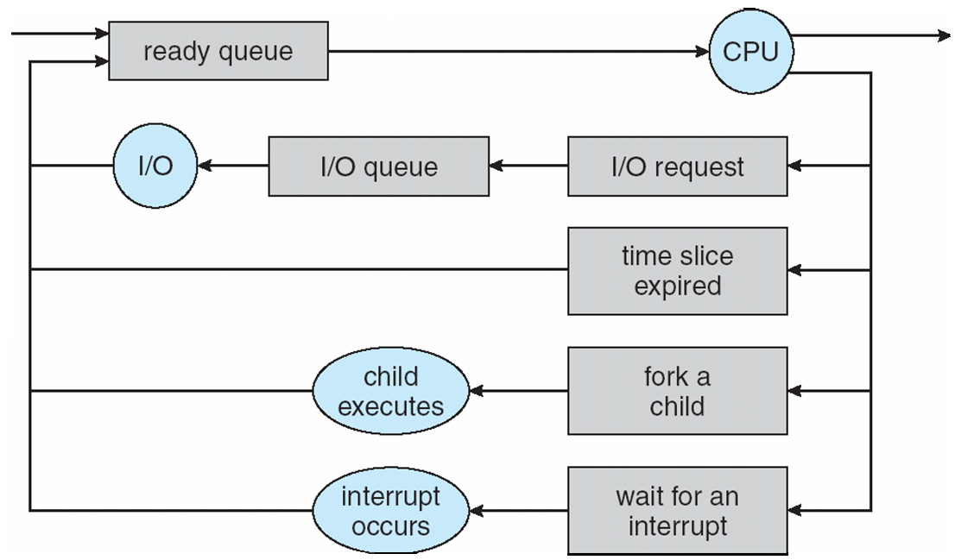
Representation of Process Scheduling

Slide 8
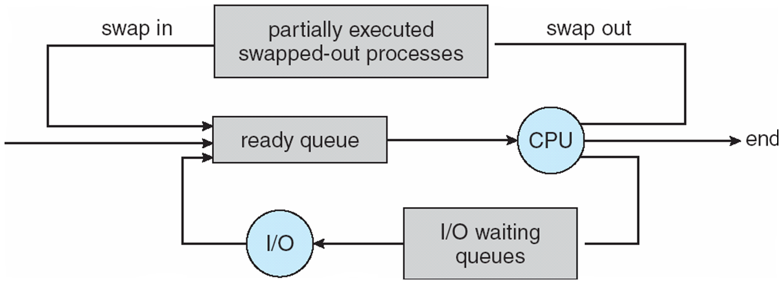
Schedulers
Long-term scheduler (or job scheduler) – selects which processes should be brought into the ready queue
Short-term scheduler (or CPU scheduler) – selects which process should be executed next and allocates CPU
Addition of Medium Term Scheduling

Slide 9
Schedulers (Cont)
Short-term scheduler is invoked very frequently (milliseconds) ⇒ (must be fast)
Long-term scheduler is invoked very infrequently (seconds, minutes) ⇒ (may be slow)
The long-term scheduler controls the degree of multiprogramming
Processes can be described as either:
  I/O-bound process – spends more time doing I/O than computations, many short CPU bursts
  CPU-bound process – spends more time doing computations; few very long CPU bursts
  Context Switch
When CPU switches to another process, the system must save the state of the old process and load the saved state for the new process via a context switch
Context of a process represented in the PCB
Context-switch time is overhead; the system does no useful work while switching
Time dependent on hardware support

Slide 10
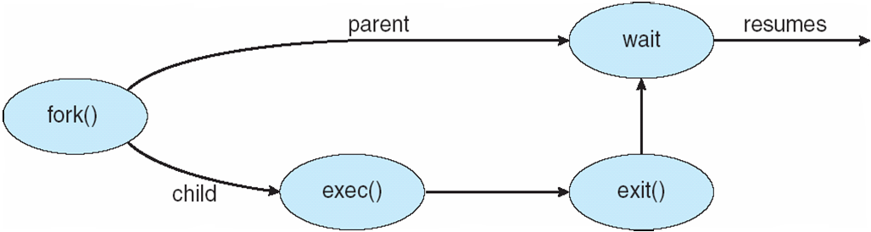
Process Creation
Parent process create children processes, which, in turn create other processes, forming a tree of processes
Generally, process identified and managed via a process identifier (pid)
Resource sharing
  Parent and children share all resources
  Children share subset of parent’s resources
  Parent and child share no resources
Execution
  Parent and children execute concurrently
  Parent waits until children terminate
Address space
  Child duplicate of parent
  Child has a program loaded into it
UNIX examples
  fork system call creates new process
  exec system call used after a fork to replace the process’ memory space with a new program

Slide 11
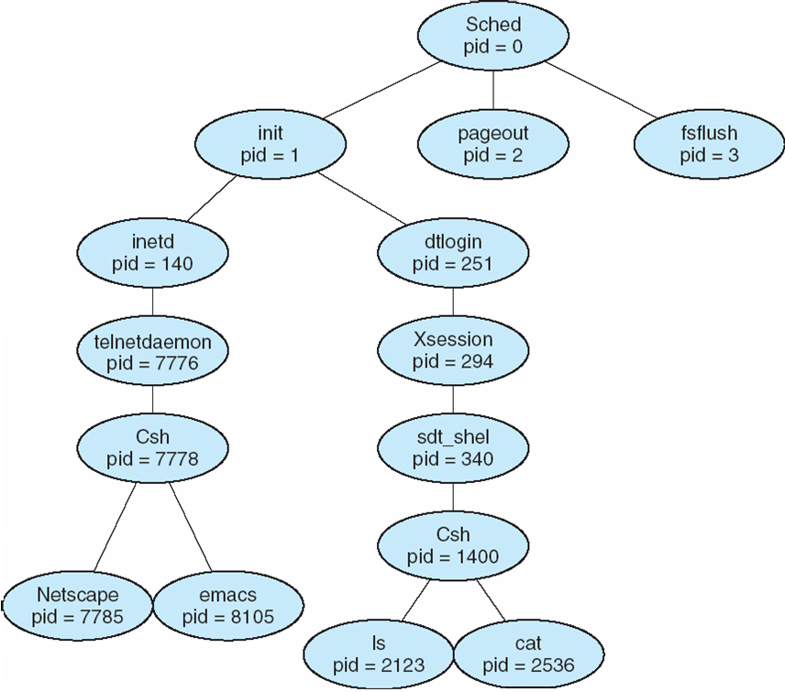
A tree of processes on a typical Solaris

Slide 12
C Program Forking Separate Process
int main()
{
pid_t pid;
/* fork another process */
pid = fork();
if (pid < 0) { /* error occurred */
fprintf(stderr, "Fork Failed");
exit(-1);
}
else if (pid == 0) { /* child process */
execlp("/bin/ls", "ls", NULL);
}
else { /* parent process */
/* parent will wait for the child to complete */
wait (NULL);
printf ("Child Complete");
exit(0);
}
}

Slide 13
Process Termination
Process executes last statement and asks the operating system to delete it (exit)
  Output data from child to parent (via wait)
  Process’ resources are deallocated by operating system
Parent may terminate execution of children processes (abort)
  Child has exceeded allocated resources
  Task assigned to child is no longer required
  If parent is exiting
    Some operating system do not allow child to continue if its parent terminates
      All children terminated - cascading termination

Slide 14
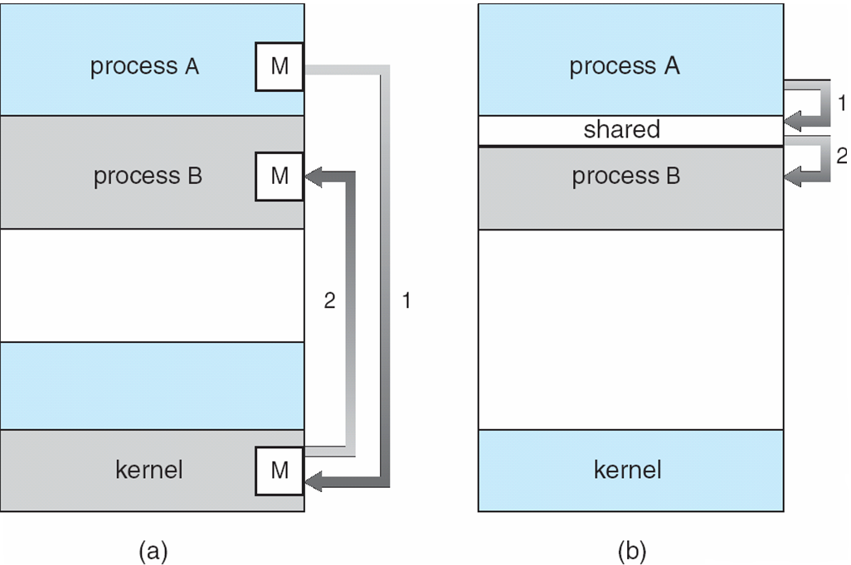
Interprocess Communication
Processes within a system may be independent or cooperating
Cooperating process can affect or be affected by other processes, including sharing data
Reasons for cooperating processes:
  Information sharing
  Computation speedup
  Modularity
  Convenience
Cooperating processes
need interprocess communication (IPC)
Two models of IPC
  Shared memory
  Message passing
  Communications Models

Slide 15
Cooperating Processes
Independent process cannot affect or be affected by the execution of another process
Cooperating process can affect or be affected by the execution of another process
Advantages of process cooperation
  Information sharing
  Computation speed-up
  Modularity
  Convenience

Slide 16
Producer-Consumer Problem
Paradigm for cooperating processes, producer process produces information that is consumed by a consumer process
  unbounded-buffer places no practical limit on the size of the buffer
  bounded-buffer assumes that there is a fixed buffer size

Slide 17
Bounded-Buffer – Shared-Memory Solution
Shared data
      #define BUFFER_SIZE 10
      typedef struct {
      . . .
      } item;
      item buffer[BUFFER_SIZE];
      int in = 0;
      int out = 0;
Solution is correct, but can only use BUFFER_SIZE-1 elements

Slide 18
Bounded-Buffer – Producer
while (true) {
/* Produce an item */
while (((in = (in + 1) % BUFFER SIZE count) == out)
; /* do nothing -- no free buffers */
buffer[in] = item;
in = (in + 1) % BUFFER SIZE;
}

Slide 19
Bounded Buffer – Consumer
while (true) {
while (in == out)
; // do nothing -- nothing to consume
// remove an item from the buffer
item = buffer[out];
out = (out + 1) % BUFFER SIZE;
return item;
}

Slide 20
Interprocess Communication – Message Passing
Mechanism for processes to communicate and to synchronize their actions
Message system – processes communicate with each other without resorting to shared variables
IPC facility provides two operations:
  send(message) – message size fixed or variable
  receive(message)
If P and Q wish to communicate, they need to:
  establish a communication link between them
  exchange messages via send/receive
Implementation of communication link
  physical (e.g., shared memory, hardware bus)
  logical (e.g., logical properties)

Slide 21
Implementation Questions
How are links established?
Can a link be associated with more than two processes?
How many links can there be between every pair of communicating processes?
What is the capacity of a link?
Is the size of a message that the link can accommodate fixed or variable?
Is a link unidirectional or bi-directional?

Slide 22
Direct Communication
Processes must name each other explicitly:
  send (P, message) – send a message to process P
  receive(Q, message) – receive a message from process Q
Properties of communication link
  Links are established automatically
  A link is associated with exactly one pair of communicating processes
  Between each pair there exists exactly one link
  The link may be unidirectional, but is usually bi-directional

Slide 23
Indirect Communication
Messages are directed and received from mailboxes (also referred to as ports)
  Each mailbox has a unique id
  Processes can communicate only if they share a mailbox
Properties of communication link
  Link established only if processes share a common mailbox
  A link may be associated with many processes
  Each pair of processes may share several communication links
  Link may be unidirectional or bi-directional

Slide 24
Indirect Communication
Operations
  create a new mailbox
  send and receive messages through mailbox
  destroy a mailbox
Primitives are defined as:
send(A, message) – send a message to mailbox A
receive(A, message) – receive a message from mailbox A

Slide 25
Indirect Communication
Mailbox sharing
  P₁, P₂, and P₃ share mailbox A
  P₁, sends; P₂ and P₃ receive
  Who gets the message?
Solutions
  Allow a link to be associated with at most two processes
  Allow only one process at a time to execute a receive operation
  Allow the system to select arbitrarily the receiver. Sender is notified who the receiver was.

Slide 26
Synchronization
Message passing may be either blocking or non-blocking
Blocking is considered synchronous
  Blocking send has the sender block until the message is received
  Blocking receive has the receiver block until a message is available
Non-blocking is considered asynchronous
  Non-blocking send has the sender send the message and continue
  Non-blocking receive has the receiver receive a valid message or null

Slide 27
Buffering
Queue of messages attached to the link; implemented in one of three ways
  1. Zero capacity – 0 messages
  Sender must wait for receiver (rendezvous)
  2. Bounded capacity – finite length of n messages
  Sender must wait if link full
  3. Unbounded capacity – infinite length
  Sender never waits

Slide 28
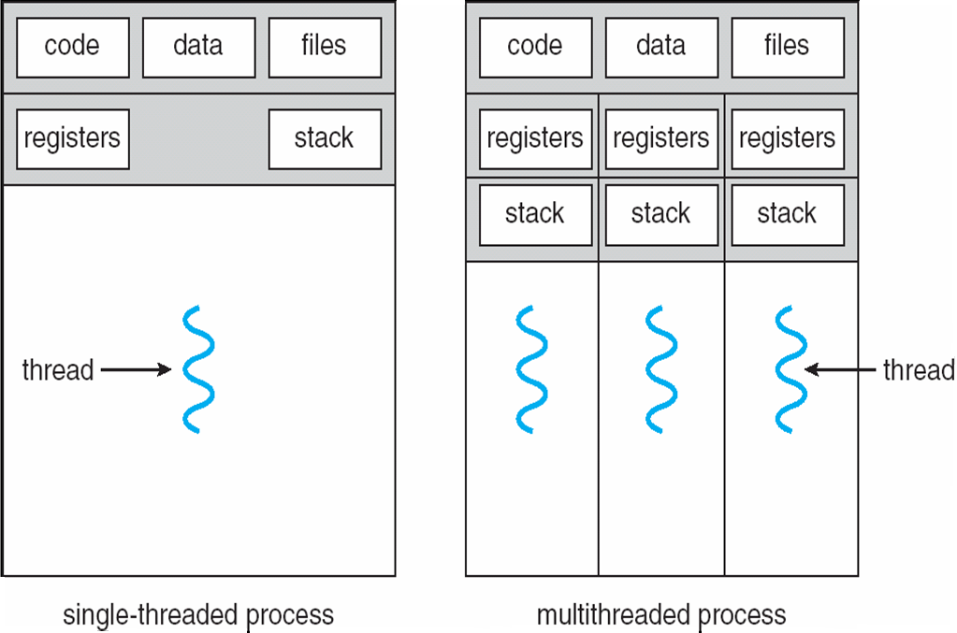
Chapter 2: Multi-threaded Programing
Single and Multithreaded Processes

Slide 29
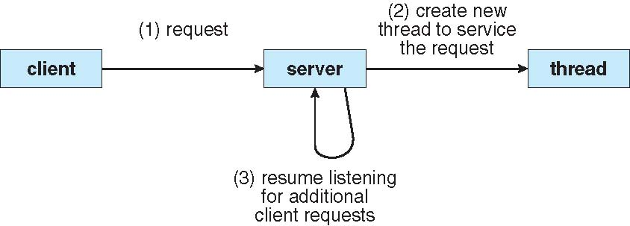
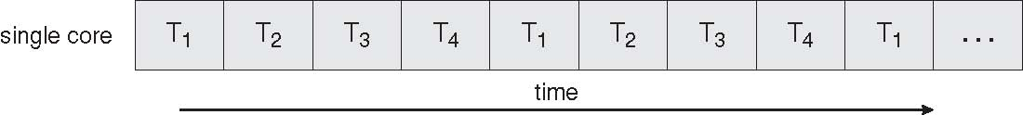
Benefits
Responsiveness
Resource Sharing
Economy
Scalability
Multithreaded Server Architecture
Concurrent Execution on a Single-core System

Slide 30
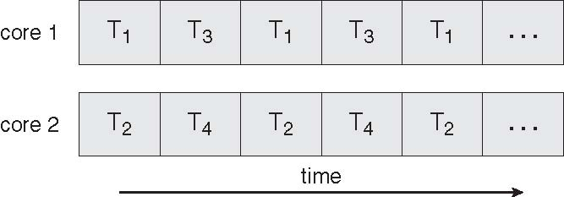
Multicore Programming
Multicore systems putting pressure on programmers, challenges include
  Dividing activities
  Balance
  Data splitting
  Data dependency
  Testing and debugging
Parallel Execution on a Multicore System

Slide 31
User Threads
Thread management done by user-level threads library
Three primary thread libraries:
  POSIX Pthreads
  Win32 threads
  Java threads

Slide 32
Kernel Threads
Supported by the Kernel
Examples
  Windows XP/2000
  Solaris
  Linux
  Tru64 UNIX
  Mac OS X

Slide 33
Multithreading Models
Many-to-One
One-to-One
Many-to-Many

Slide 34
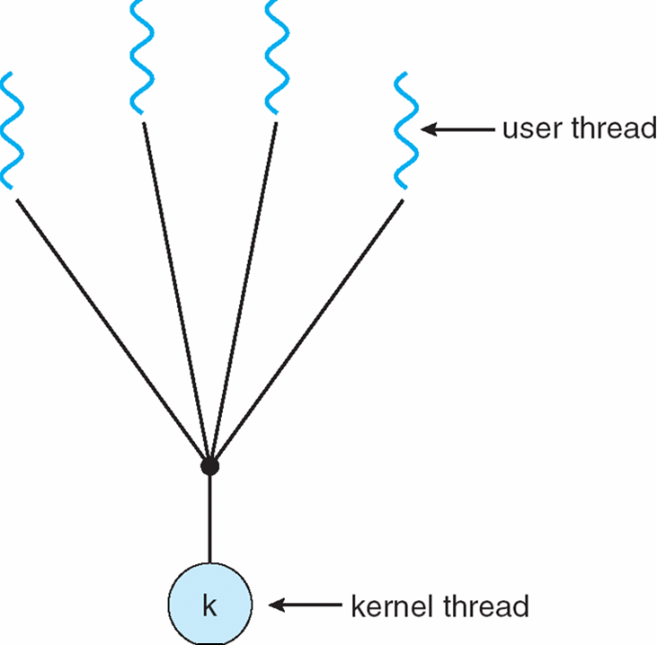
Many-to-One
Many user-level threads mapped to single kernel thread
Examples:
  Solaris Green Threads
  GNU Portable Threads

Slide 35
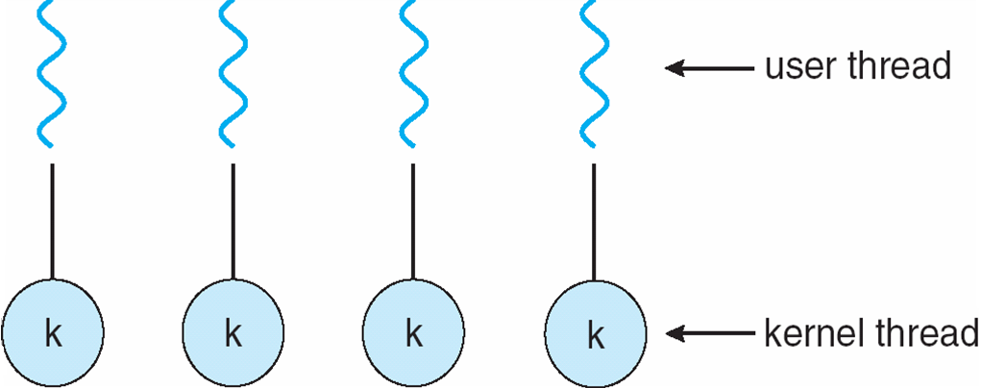
One-to-One
Each user-level thread maps to kernel thread
Examples
  Windows NT/XP/2000
  Linux
  Solaris 9 and later

Slide 36
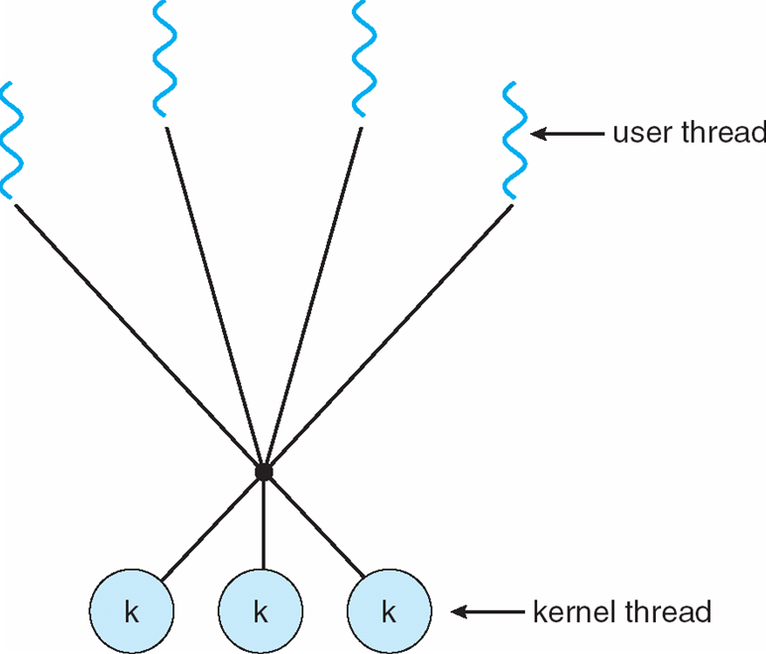
Many-to-Many Model
Allows many user level threads to be mapped to many kernel threads
Allows the operating system to create a sufficient number of kernel threads
Solaris prior to version 9
Windows NT/2000 with the ThreadFiber package

Slide 37
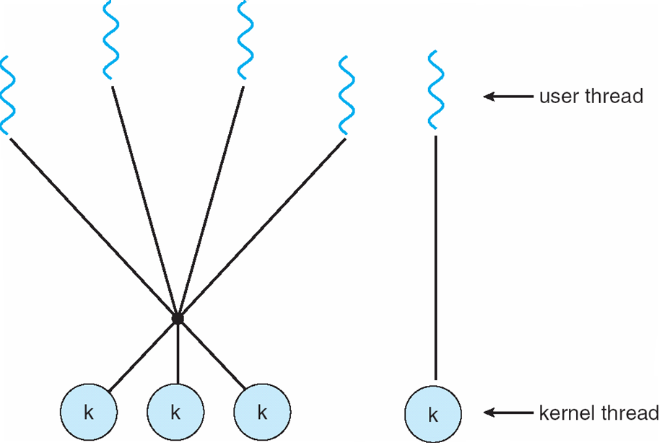
Two-level Model
Similar to M:M, except that it allows a user thread to be bound to kernel thread
Examples
  IRIX
  HP-UX
  Tru64 UNIX
  Solaris 8 and earlier

Slide 38
Thread Libraries
Thread library provides programmer with API for creating and managing threads
Two primary ways of implementing
  Library entirely in user space
  Kernel-level library supported by the OS
  Pthreads
May be provided either as user-level or kernel-level
A POSIX standard (IEEE 1003.1c) API for thread creation and synchronization
API specifies behavior of the thread library, implementation is up to development of the library
Common in UNIX operating systems (Solaris, Linux, Mac OS X)

Slide 39
Java Threads
Java threads are managed by the JVM
Typically implemented using the threads model provided by underlying OS
Java threads may be created by:
  Extending Thread class
  Implementing the Runnable interface

Slide 40
Threading Issues
Semantics of fork() and exec() system calls
Thread cancellation of target thread
  Asynchronous or deferred
Signal handling
Thread pools
Thread-specific data
Scheduler activations
Semantics of fork() and exec()
Does fork() duplicate only the calling thread or all threads?

Slide 41
Thread Cancellation
Terminating a thread before it has finished
Two general approaches:
  Asynchronous cancellation terminates the target thread immediately
  Deferred cancellation allows the target thread to periodically check if it should be cancelled

Slide 42
Signal Handling
Signals are used in UNIX systems to notify a process that a particular event has occurred
A signal handler is used to process signals
  Signal is generated by particular event
  Signal is delivered to a process
  Signal is handled
Options:
  Deliver the signal to the thread to which the signal applies
  Deliver the signal to every thread in the process
  Deliver the signal to certain threads in the process
  Assign a specific threa to receive all signals for the process

Slide 43
Thread Pools
Create a number of threads in a pool where they await work
Advantages:
  Usually slightly faster to service a request with an existing thread than create a new thread
  Allows the number of threads in the application(s) to be bound to the size of the pool

Slide 44
Thread Specific Data
Allows each thread to have its own copy of data
Useful when you do not have control over the thread creation process (i.e., when using a thread pool)

Slide 45
Chapter 3: Scheduler Activations
Both M:M and Two-level models require communication to maintain the appropriate number of kernel threads allocated to the application
Scheduler activations provide upcalls - a communication mechanism from the kernel to the thread library
This communication allows an application to maintain the correct number kernel threads
Basic Concepts
Maximum CPU utilization obtained with multiprogramming
CPU–I/O Burst Cycle – Process execution consists of a cycle of CPU execution and I/O wait
CPU burst distribution

Slide 46
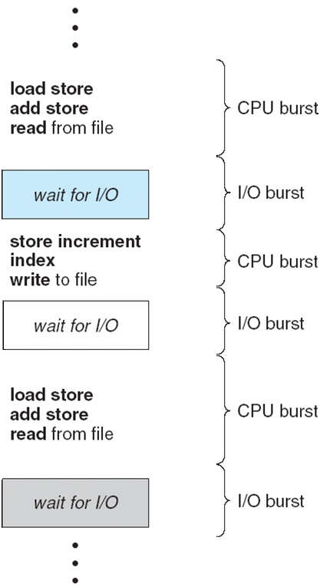
Alternating Sequence of CPU And I/O Bursts

Slide 47
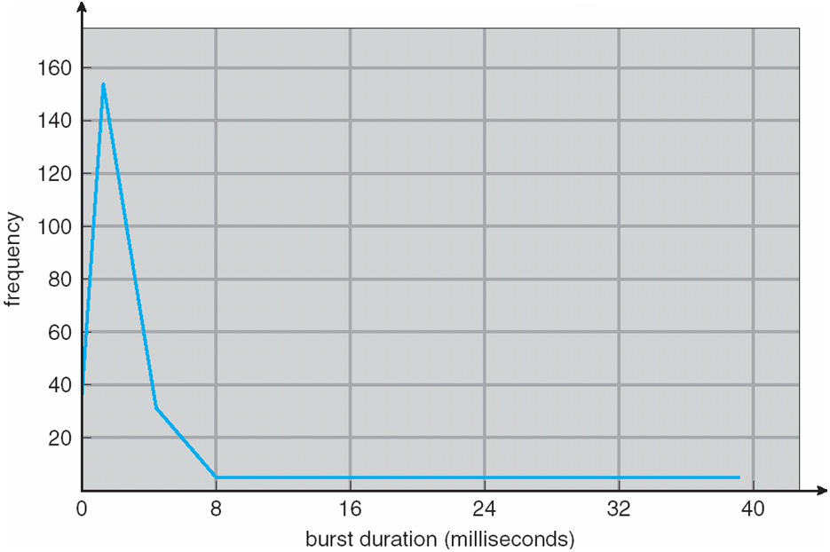
Histogram of CPU-burst Times

Slide 48
CPU Scheduler
Selects from among the processes in memory that are ready to execute, and allocates the CPU to one of them
CPU scheduling decisions may take place when a process:
  1. Switches from running to waiting state
  2. Switches from running to ready state
  3. Switches from waiting to ready
  4. Terminates
Scheduling under 1 and 4 is nonpreemptive
All other scheduling is preemptive

Slide 49
Dispatcher
Dispatcher module gives control of the CPU to the process selected by the short-term scheduler; this involves:
  switching context
  switching to user mode
  jumping to the proper location in the user program to restart that program
Dispatch latency – time it takes for the dispatcher to stop one process and start another running

Slide 50
Scheduling Criteria
CPU utilization – keep the CPU as busy as possible
Throughput – # of processes that complete their execution per time unit
Turnaround time – amount of time to execute a particular process
Waiting time – amount of time a process has been waiting in the ready queue
Response time – amount of time it takes from when a request was submitted until the first response is produced, not output (for time-sharing environment)

Slide 51
Scheduling Algorithm Optimization Criteria
Max CPU utilization
Max throughput
Min turnaround time
Min waiting time
Min response time

Slide 52
Scheduling Algorithm
First-Come, First-Served (FCFS) Scheduling
Process Burst Time
P₁ 24
P₂ 3
P₃ 3
Suppose that the processes arrive in the order: P₁ , P₂ , P₃
The Gantt Chart for the schedule is:
Waiting time for P₁ = 0; P₂ = 24; P₃ = 27
Average waiting time: (0 + 24 + 27)/3 = 17
P₁
P₂
P₃
0
24
27
30

Slide 53
Scheduling Algorithm
FCFS Scheduling (Cont)
Suppose that the processes arrive in the order
P₂ , P₃ , P₁
The Gantt chart for the schedule is:
Waiting time for P₁ = 6; P₂ = 0; P₃ = 3
Average waiting time: (6 + 0 + 3)/3 = 3
Much better than previous case
Convoy effect short process behind long process
P₂
P₃
P₁
0
3
6
30

Slide 54
Scheduling Algorithm
Shortest-Job-First (SJF) Scheduling
Associate with each process the length of its next CPU burst. Use these lengths to schedule the process with the shortest time
SJF is optimal – gives minimum average waiting time for a given set of processes
  The difficulty is knowing the length of the next CPU request

Slide 55
Example of SJF
Process Arrival Time Burst Time
P₁ 0.0 6
P₂ 2.0 8
P₃ 4.0 7
P₄ 5.0 3
SJF scheduling chart
Average waiting time = (3 + 16 + 9 + 0) / 4 = 7
P₄
P₁
P₃
P₂
0
3
9
16
24

Slide 56
Determining Length of Next CPU Burst
Can only estimate the length
Can be done by using the length of previous CPU bursts, using exponential averaging

Slide 57
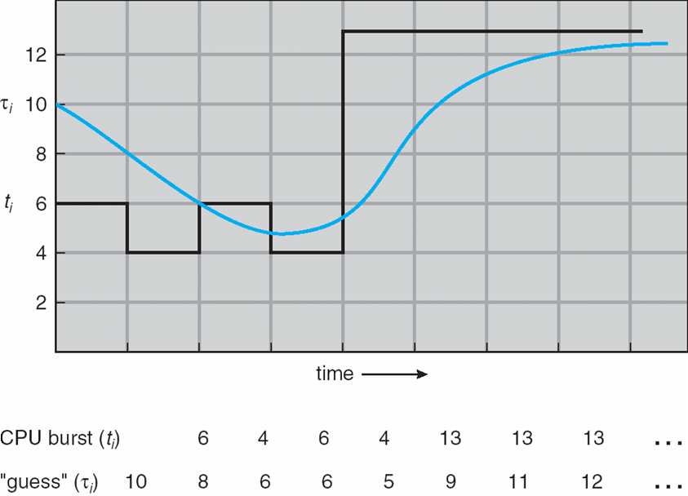
Prediction of the Length of the Next CPU Burst

Slide 58
Examples of Exponential Averaging
α =0
  τ_{n+1} = τ_{n}
  Recent history does not count
α =1
  τ_{n+1} = α t_{n}
  Only the actual last CPU burst counts
If we expand the formula, we get:
    τ_{n+1} = α t_{n}+(1 - α)α t_{n} -1 + …
    +(1 - α )^{j} α t_{n} _{-j} + …
    +(1 - α )^{n +1} τ₀
Since both α and (1 - α) are less than or equal to 1, each successive term has less weight than its predecessor

Slide 59
Scheduling Algorithm
Priority Scheduling
A priority number (integer) is associated with each process
The CPU is allocated to the process with the highest priority (smallest integer ≡ highest priority)
  Preemptive
  nonpreemptive
SJF is a priority scheduling where priority is the predicted next CPU burst time
Problem ≡ Starvation – low priority processes may never execute
Solution ≡ Aging – as time progresses increase the priority of the process

Slide 60
Scheduling Algorithm
Round Robin (RR)
Each process gets a small unit of CPU time (time quantum), usually 10-100 milliseconds. After this time has elapsed, the process is preempted and added to the end of the ready queue.
If there are n processes in the ready queue and the time quantum is q, then each process gets 1/n of the CPU time in chunks of at most q time units at once. No process waits more than (n-1)q time units.
Performance
  q large ⇒ FIFO
  q small ⇒ q must be large with respect to context switch, otherwise overhead is too high

Slide 61
Example of RR with Time Quantum = 4
Process Burst Time
P₁ 24
P₂ 3
P₃ 3
The Gantt chart is:
Typically, higher average turnaround than SJF, but better response
P₁
P₂
P₃
P₁
P₁
P₁
P₁
P₁
0
4
7
10
14
18
22
26
30

Slide 62
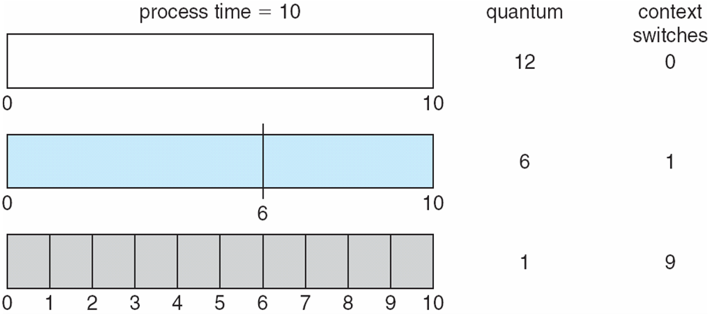
Time Quantum and Context Switch Time

Slide 63
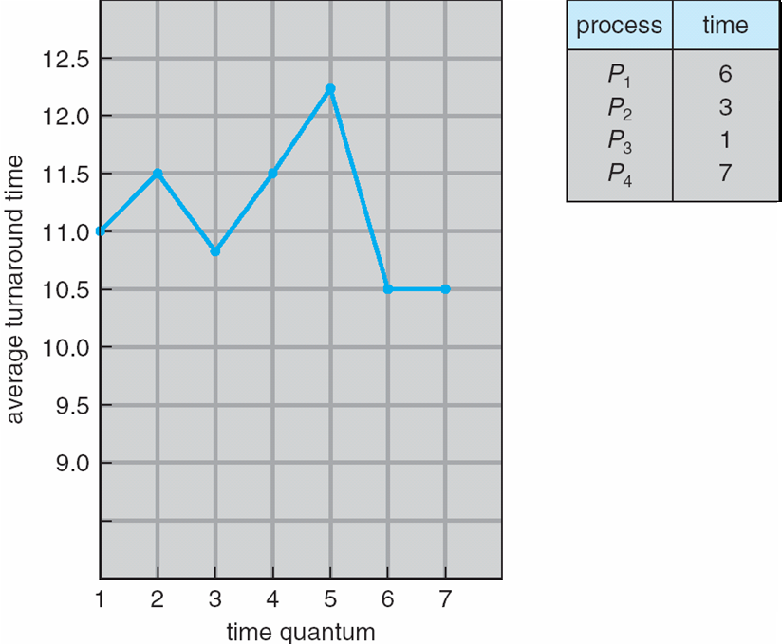
Turnaround Time Varies With The Time Quantum

Slide 64
Scheduling Algorithm
Multilevel Queue
Ready queue is partitioned into separate queues:
foreground (interactive)
background (batch)
Each queue has its own scheduling algorithm
  foreground – RR
  background – FCFS
Scheduling must be done between the queues
  Fixed priority scheduling; (i.e., serve all from foreground then from background). Possibility of starvation.
  Time slice – each queue gets a certain amount of CPU time which it can schedule amongst its processes; i.e., 80% to foreground in RR
  20% to background in FCFS

Slide 65
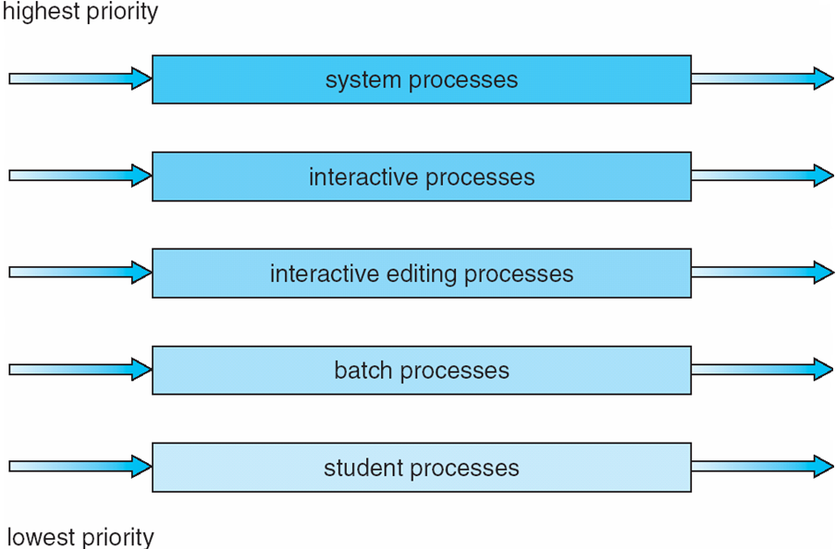
Multilevel Queue Scheduling

Slide 66
Scheduling Algorithm
Multilevel Feedback Queue
A process can move between the various queues; aging can be implemented this way
Multilevel-feedback-queue scheduler defined by the following parameters:
  number of queues
  scheduling algorithms for each queue
  method used to determine when to upgrade a process
  method used to determine when to demote a process
  method used to determine which queue a process will enter when that process needs service

Slide 67
Example of Multilevel Feedback Queue
Three queues:
  Q₀ – RR with time quantum 8 milliseconds
  Q₁ – RR time quantum 16 milliseconds
  Q₂ – FCFS
Scheduling
  A new job enters queue Q₀ which is served FCFS. When it gains CPU, job receives 8 milliseconds. If it does not finish in 8 milliseconds, job is moved to queue Q₁.
  At Q₁ job is again served FCFS and receives 16 additional milliseconds. If it still does not complete, it is preempted and moved to queue Q₂.

Slide 68
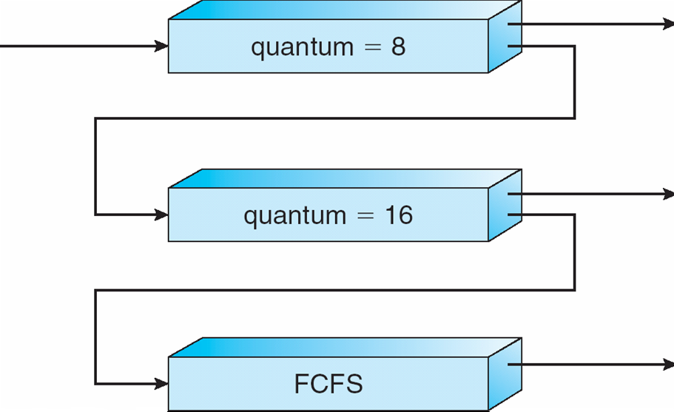
Multilevel Feedback Queues

Slide 69
Thread Scheduling
Distinction between user-level and kernel-level threads
Many-to-one and many-to-many models, thread library schedules user-level threads to run on LWP
  Known as process-contention scope (PCS) since scheduling competition is within the process
Kernel thread scheduled onto available CPU is system-contention scope (SCS) – competition among all threads in system

Slide 70
Pthread Scheduling
API allows specifying either PCS or SCS during thread creation
  PTHREAD SCOPE PROCESS schedules threads using PCS scheduling
  PTHREAD SCOPE SYSTEM schedules threads using SCS scheduling.

Slide 71
Multiple-Processor Scheduling
CPU scheduling more complex when multiple CPUs are available
Homogeneous processors within a multiprocessor
Asymmetric multiprocessing – only one processor accesses the system data structures, alleviating the need for data sharing
Symmetric multiprocessing (SMP) – each processor is self-scheduling, all processes in common ready queue, or each has its own private queue of ready processes
Processor affinity – process has affinity for processor on which it is currently running
  soft affinity
  hard affinity

Slide 72
Pthread Scheduling API
#include <pthread.h>
#include <stdio.h>
#define NUM THREADS 5
int main(int argc, char *argv[])
{
int i;
pthread t tid[NUM THREADS];
pthread attr t attr;
/* get the default attributes */
pthread attr init(&attr);
/* set the scheduling algorithm to PROCESS or SYSTEM */
pthread attr setscope(&attr, PTHREAD SCOPE SYSTEM);
/* set the scheduling policy - FIFO, RT, or OTHER */
pthread attr setschedpolicy(&attr, SCHED OTHER);
/* create the threads */
for (i = 0; i < NUM THREADS; i++)
pthread create(&tid[i],&attr,runner,NULL);

Slide 73
Pthread Scheduling API
/* now join on each thread */
for (i = 0; i < NUM THREADS; i++)
pthread join(tid[i], NULL);
}
/* Each thread will begin control in this function */
void *runner(void *param)
{
printf("I am a thread\n");
pthread exit(0);
}

Slide 74
Multicore Processors
Recent trend to place multiple processor cores on same physical chip
Faster and consume less power
Multiple threads per core also growing
  Takes advantage of memory stall to make progress on another thread while memory retrieve happens

Slide 75
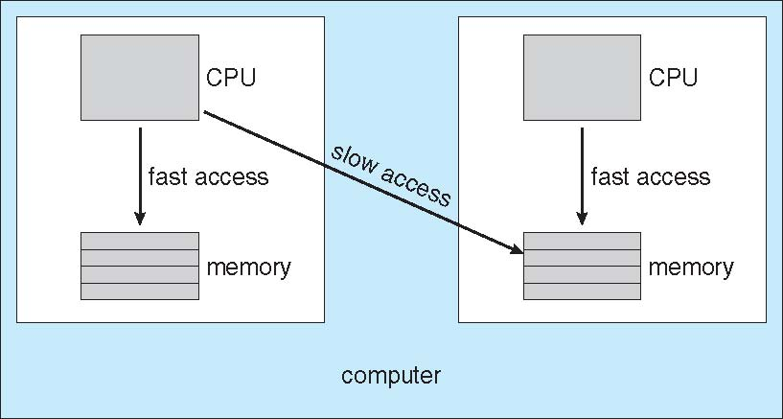
NUMA and CPU Scheduling

Slide 76
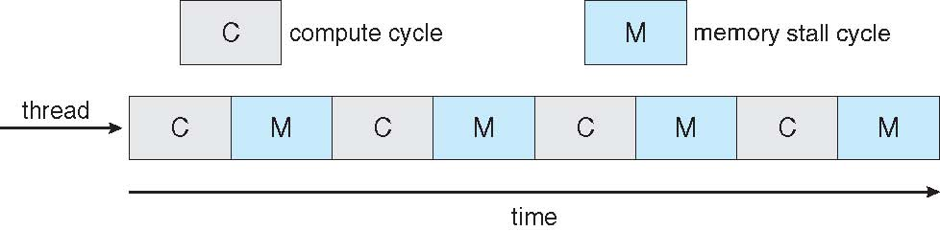
Multithreaded Multicore System

Slide 77
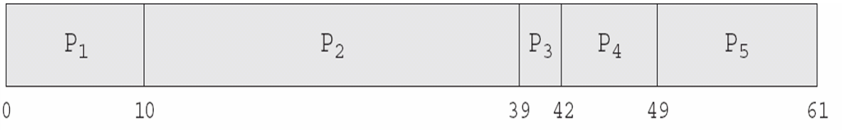
In-5.7

Slide 78
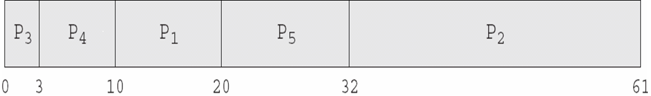
In-5.8

